Slide 1
Computer Science
Tony Gaddis 5th Ed Starting Out with C++
Chapter 1
Introduction to Computers and Programming
Mohammad Al-Husseini

Slide 2
Why Program?
Computers are excellent at performing repetitive and analytical actions quickly
Who would benefit from this? Everyone
Accountants balance books and profits/losses
Factory workers control manufacturing machines
Mechanics test computer systems in vehicles
Scientists run millions of calculations on data
End users benefit from drivers and software
But these individuals likely do not possess the skills to write the software they use and need

Slide 3
Hardware and Software
Hardware
Central Processing Unit (CPU)
Fetches, Decodes, and Executes instructions
Consists of two components
Arithmetic and Logic Unit (ALU) – performs mathematical operations
Control Unit – sends electrical signals to the other components of the computer to perform operations
Main Memory (RAM)
Divided into sections consisting of 8 bits or a byte
Each byte is assigned a unique address
When power is lost, the memory is erased

Slide 4
Hardware and Software
Hardware
Secondary Storage Devices (HDD/SSD/USB)
Long term memory that does not lose data during power loss
Stores programs and data until it is needed and loaded into RAM, which is faster
Input Devices
Any interface which puts information into the computer
Mouse, keyboard, microphone, CD/DVD, USB, internet, etc.

Slide 5
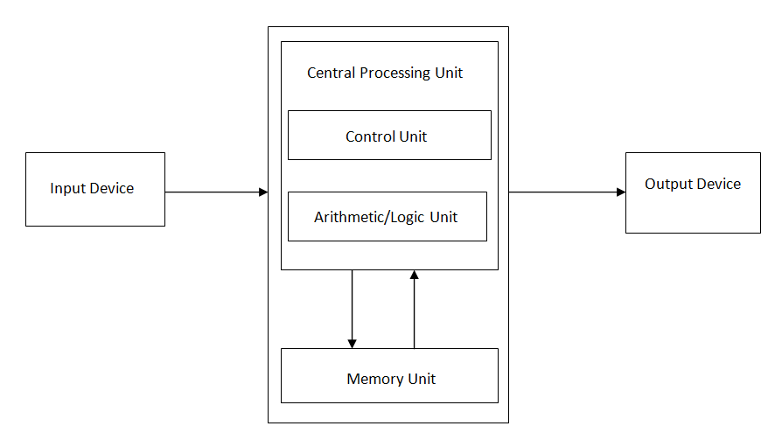
Hardware and Software
Hardware
Output Devices
Any device which sends information out of the computer
Monitor, speakers, printer, CD/DVD-R, USB, internet, etc.

Slide 6
Hardware and Software
Software
Two categories:
Operating Systems – manages the computer’s hardware and controls their processes
Single Tasking – Capable of running only a single program at a time, such as MS-DOS
Multitasking – Capable of running multiple programs at a time
Note: Still only runs one instruction at a time, but very quickly (3 GHz processor – 3 billion cycles per second)
Also differentiates as single-user or multi-user
Applications / Programs – makes the computer useful to the user by solving problems or running operations

Slide 7
What Is a Program?
A set of instructions that tells the computer how to solve a problem or perform a task
Gross Pay
Display: “How many hours did you work?”
Wait: For user input
Store: The user input in memory
Repeat: For Hourly Pay
Multiply: Hours Worked by Hourly Pay
Store: The result in memory
Display: “You earned “ result “ money.”
This is an algorithm (a set of instructions)

Slide 8
What Is a Program?
But there’s one problem
Computers don’t speak English
They speak Machine Code – a string of binary numbers (10100011)
Okay, there’s another problem
Human’s don’t speak Machine Code
And that Machine Code can very between systems
Thus a middle ground: Programming Languages (C++)
Which get converted into Machine Code

Slide 9
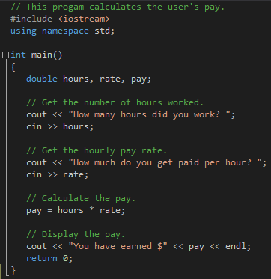
What Is a Program?
Gross Pay Example
How many hours did you work? 10 [Enter]
How much do you get paid per hour? 15 [Enter]
You have earned $150

Slide 10
Programming Languages
Low-Level Programming Languages
Closer to Machine Code
Ex. Assembly
High-Level Programming Languages
Closer to English
Ex. BASIC, FORTRAN, COBOL, Pascal, C/C++/C#, Java, Visual Basic, etc.
Portability – a program’s ability to be run on various types of systems
C++ excels for it’s high-level ease with low-level functionality and reasonable portability

Slide 11
Code Transformation
Source Code
Written by the programmer as seen on slide 9
Still primarily English due to being high-level
Preprocessor
Takes the source code and modifies it based on any preprocessor directives (#)
Creates a modified source code file
Compiler
Converts the modified source code into machine language, checking for syntax errors
Creates an object code file

Slide 12
Code Transformation
Linker
Takes the object code and mixes it with libraries and hardware specific code
Creates an executable code file (exe)
This .exe file can then be run on the computer
Source Code
Pre processor
Modified Source Code
Object Code
Executable
Code
Compiler
Linker

Slide 13
What Makes a Program?
Key Words
Reserved words that have special meaning and can only be used for their intended purpose
All keywords are lowercase
#include, using namespace, main, double, return
Programmer-Defined Identifiers
Words created with by the programmer to represent variables or routines
hours, rate, pay

Slide 14
What Makes a Program?
Operators
Perform operations on one or more operands, usually numbers or values
* represents multiplication between hours and rate
= sets pay equal to the calculation on the right
Punctuation
Characters that mark the start or end of a statement or separate items in a list
, separating variables
; marking the end of a statement

Slide 15
What Makes a Program?
Syntax
The grammar dictating how keywords and operators may be used and when to use punctuation
Note that whitespace does not matter in the program (aside from strings)
But good use of spacing should be used to improve code readability

Slide 16
What Makes a Program?
Lines and Statements
Lines represent the horizontal rows of code
Statements are any complete instruction of code, causing the computer to perform an action, generally terminated by a semicolon
cout << “How many hours did you work? “;
Note that this is a line because it does not appear on two lines and a statement because it is terminated by a semicolon

Slide 17
What Makes a Program?
Variables
Represents a location in memory with a distinct address that holds a piece of information
Think of a mailbox
The name we assign to a variable is symbolic, usually representing the kind of data it is going to hold
pay holds the result of hours * rate
We could refer to pay by its address, but it is more complex, abstract, and difficult to remember

Slide 18
What Makes a Program?
Variable
Two general types of data: numbers and characters
Numbers can be separated further
Integers: 5, 7, -129, 32154
Floating-Point: 3.14159, -6.7, 0.14
You must know what type of variable to create based on the type of data it will hold
hours, rate, and pay can hold floating-point or decimal numbers, so they are declared double
More on that in Chapter 2

Slide 19
Input, Process, Output
Input
Get information from the user
cin >> hours;
cin >> rate;
Process
Do something on that information
pay = hours * rate;
Output
Give the result to the user so that it is useful or request information
cout << “You have earned $” << pay << endl;
cout << “How many hours did you work? “;

Slide 20
Designing and Creating
Define what the program will do.
Visualize the program running on the computer.
Use design tools such as a hierarchy chart, flowcharts, or pseudocode to model the program.
Check the model for logic errors.
Type the code, save, and compile.
Correct any errors found. Repeat steps 5 and 6 until no more errors are found.

Slide 21
Designing and Creating
Run the program with test data.
Correct any run-time errors or incorrect results. Repeat steps 5 through 8 until completely correct.

Slide 22
Procedural and OOP
You will learn both methods over the duration of this course
Procedural Programming is focused on passing data between multiple procedures
Object-Oriented Programming (OOP) is focused on storing data and procedures that work on that data within an object and passing the object

